Slide 1
暑研总结
苏星宇 能动52

Slide 2
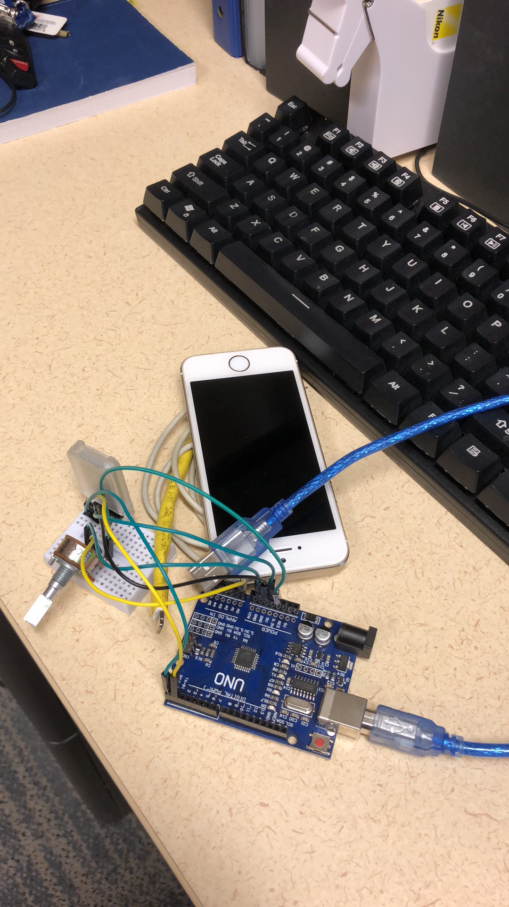
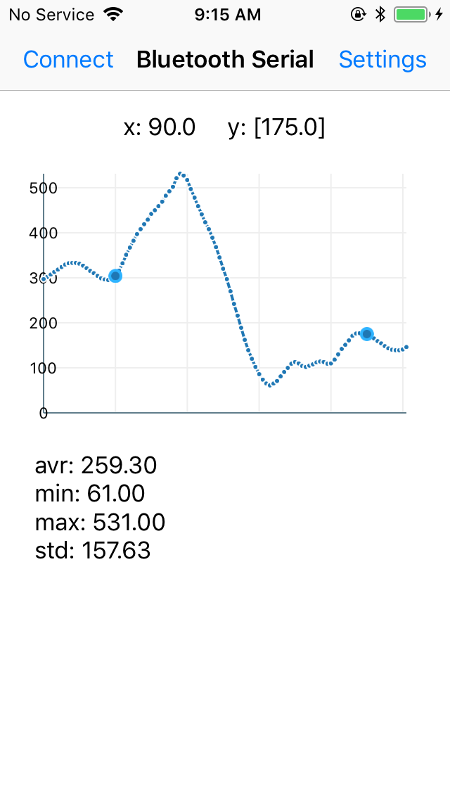
iOS BLE Application
Add some functions
Revise some errors
Improve code performance

Slide 3
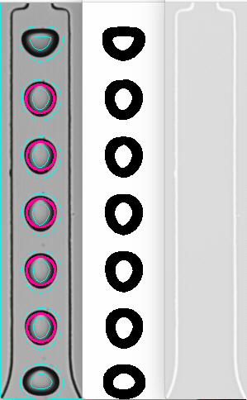






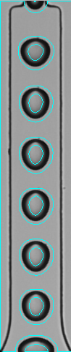

iOS Droplet Counter
demo
method
background subtraction and morphology operation

Slide 4
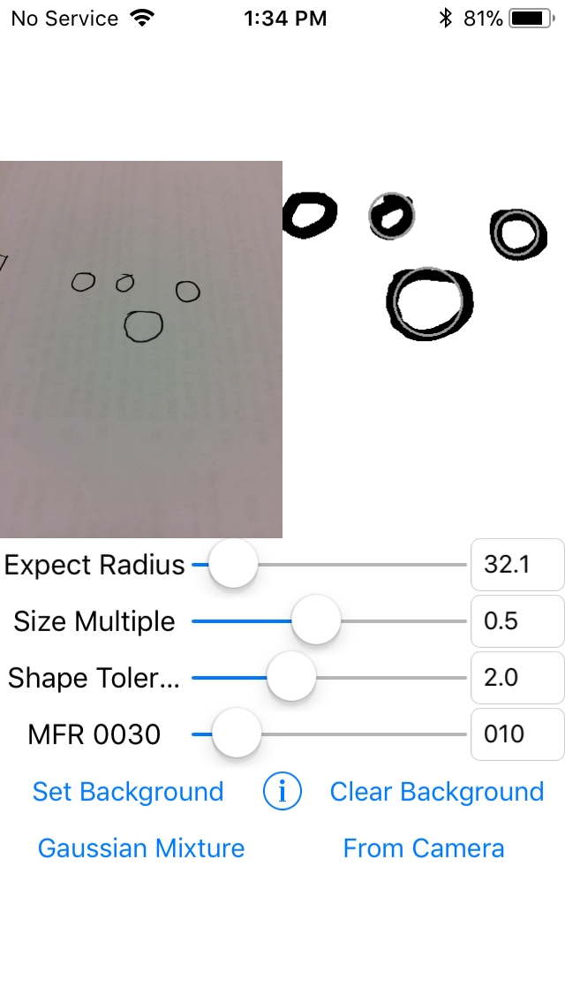
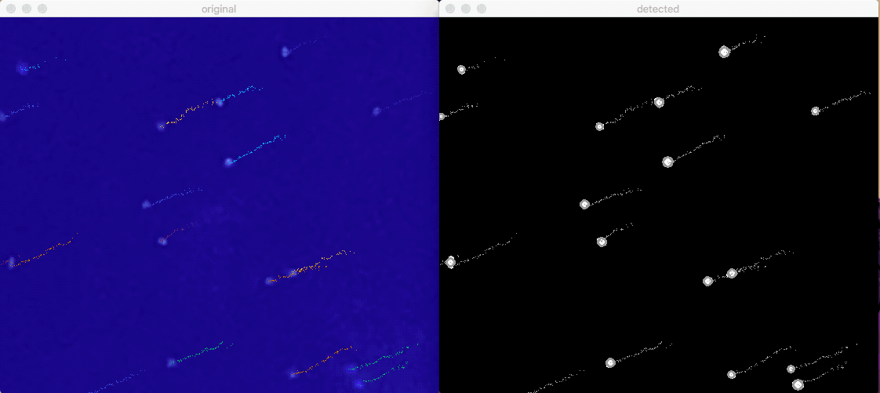
iOS Droplet Counter
demo
neighbor search tracking

Slide 5
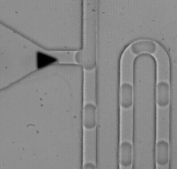
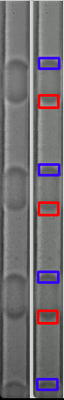
Image Based Sorter
C++ Project
Fast Camera (1000+ fps)
OpenCV
Template matching
Length decoding
Trigger sending

Slide 6
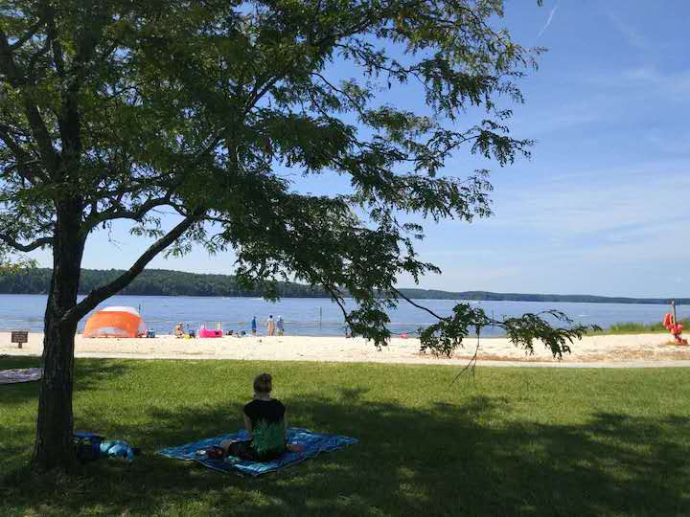
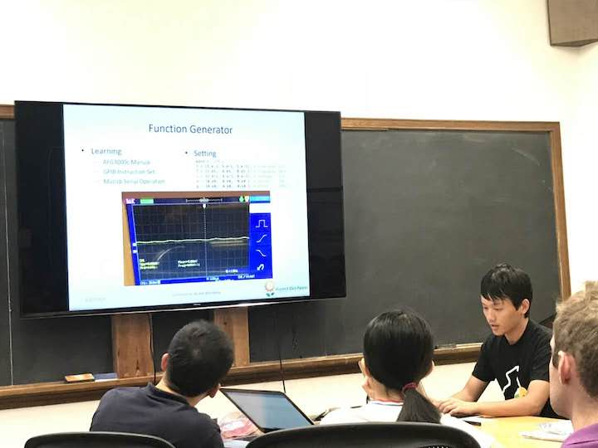
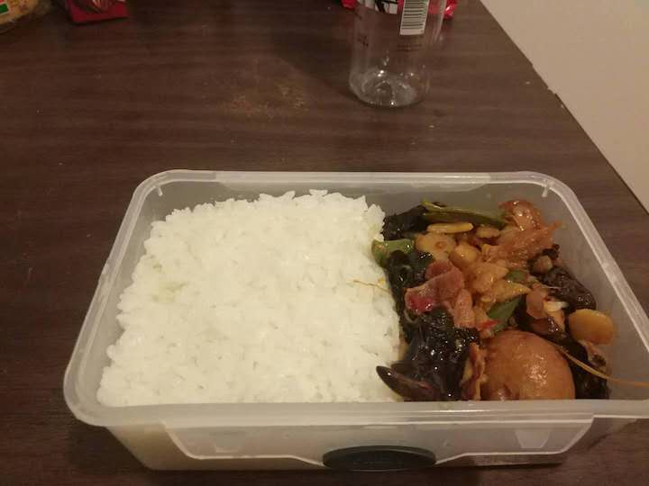
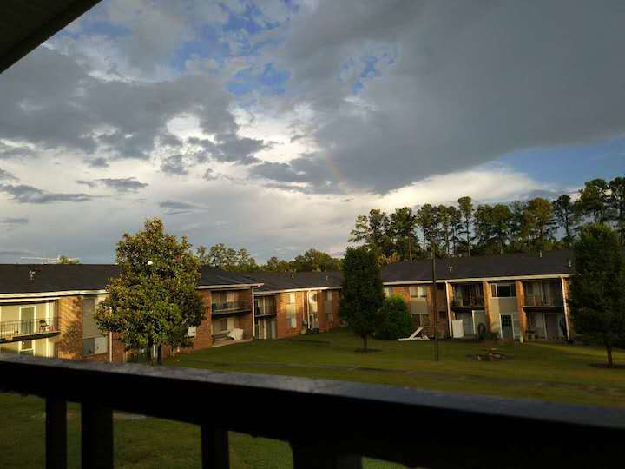
About Daily Life
Environment
Atmosphere
Safety
Food

Slide 7
THANKS

